Slide 1


Slide 2
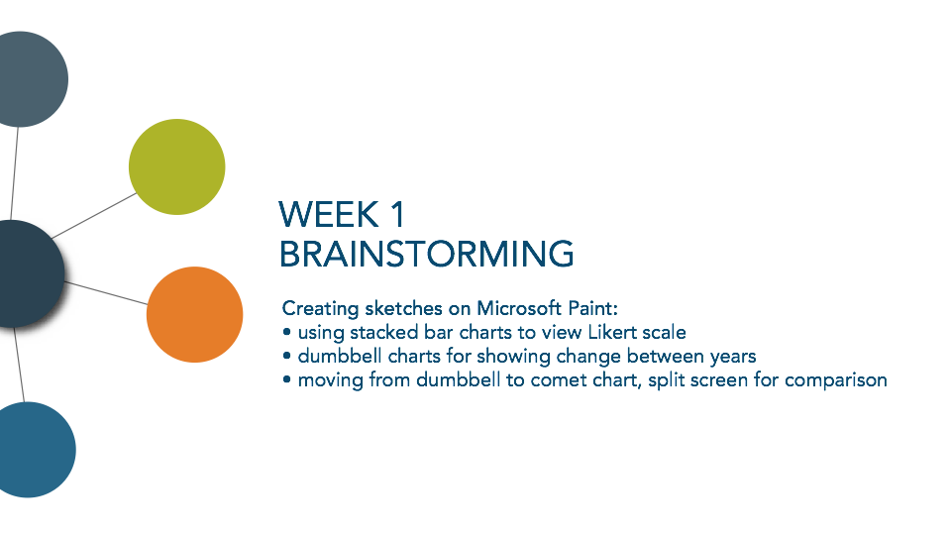

Slide 3
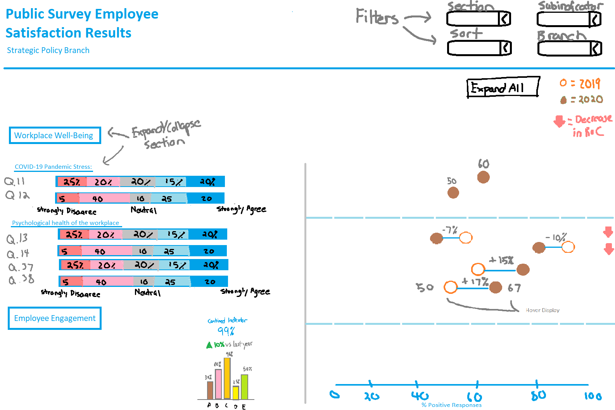
Initial Sketch of PSES Dashboard in MS Paint
Description
Stacked barchart on left shows distribution of responses upon expanding
Unexpanded section only has bar chart with combined average
Dumbell chart shows change in percent between 2019-2020, with colored arrow indicating decreases

Slide 4
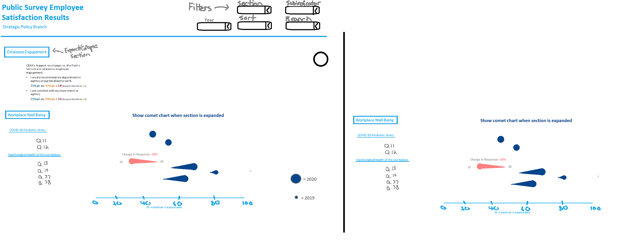
Comet Chart Conceptualization in MS Paint
Description
Idea to replace dumbbell chart with comet chart.
Discussion
Shows the same information, but it is easier to see the change in percent by coloring comets that have a negative change overall.
Also another idea to expand the section for comparison of another branch, but this type of graph takes up too much space for a split-screen comparison

Slide 5
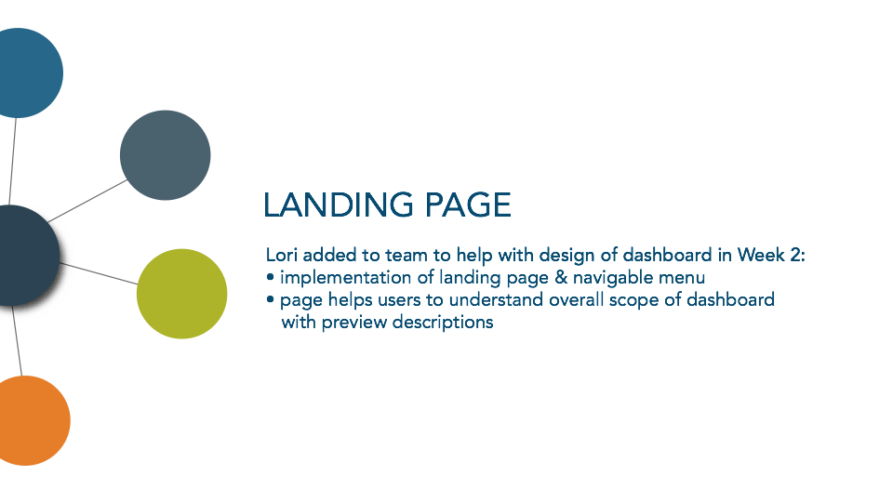

Slide 6
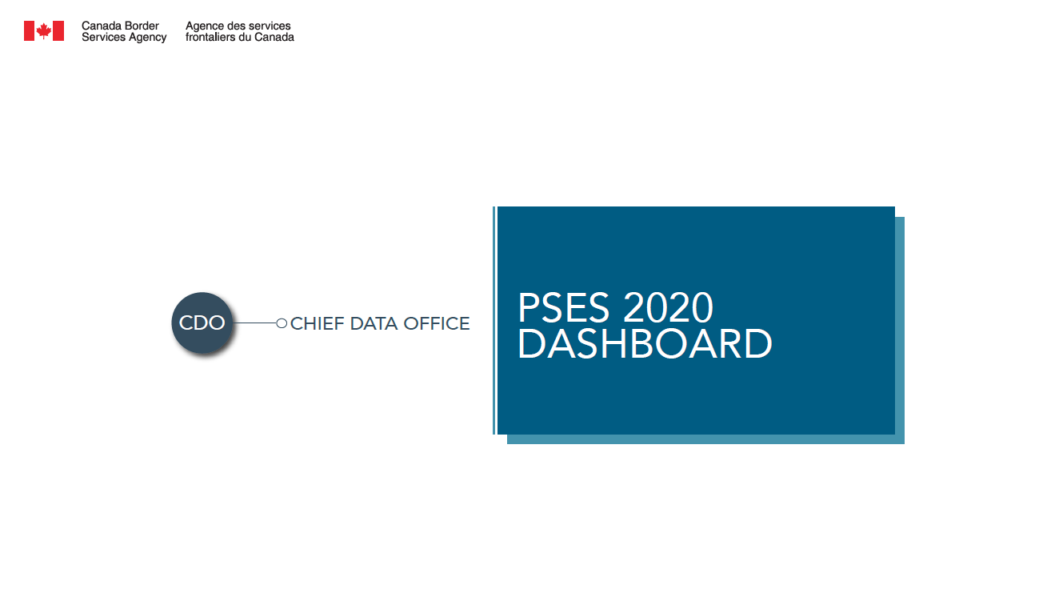

Landing Page Conceptualization
Week 2 - Deciding on the style/theme for dashboard
Discussion on whether we should use padding colors or stick with a minimalistic look
Decided to move forward with a cleaner, minimalistic look in second design to match with white background of dashboard

Slide 7
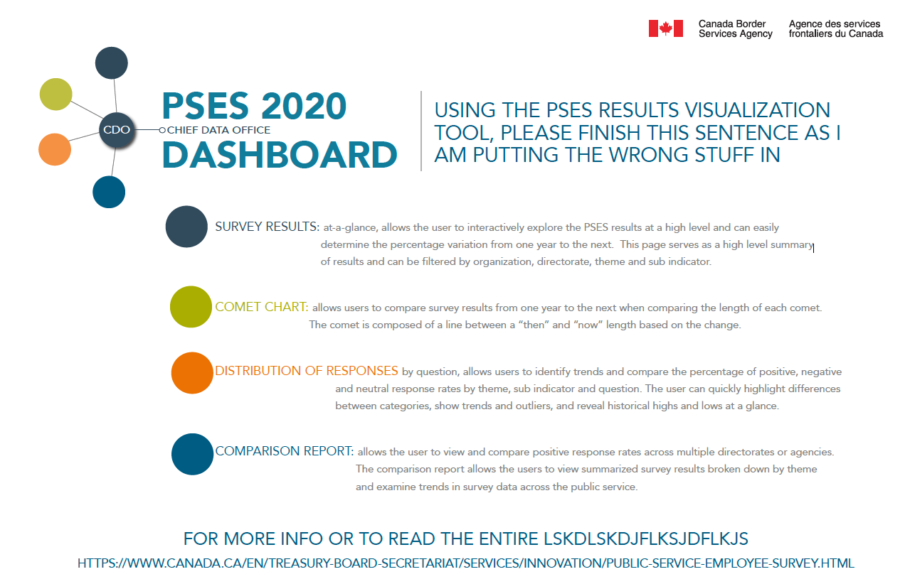
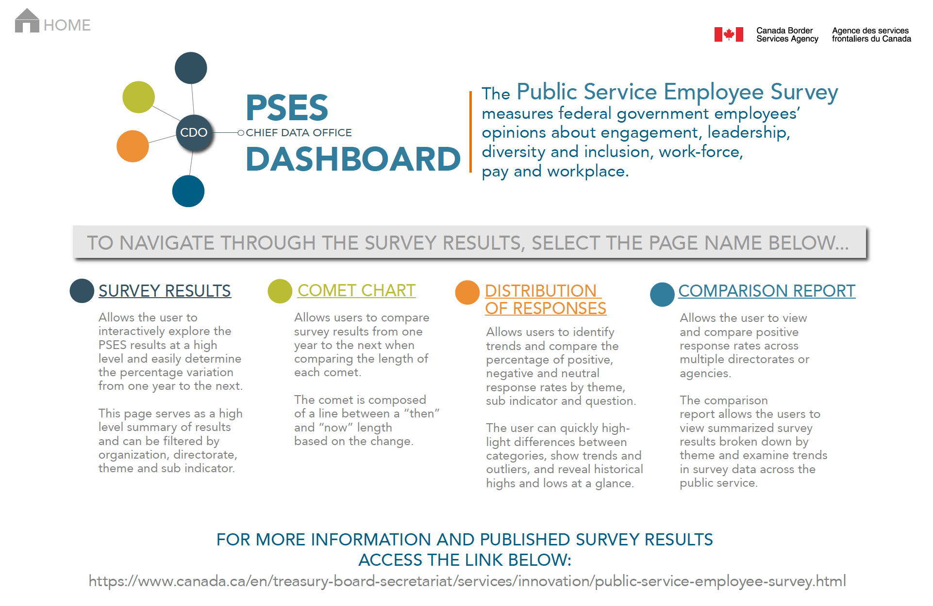
Landing Page Iterations
Week 2.5 - Implementing text descriptions
Discussed various designs for landing page
Navigation menu is on left-side of screen for other pages, so we decided with a similar design to left iteration for redundancy in UI interaction. This makes it easier to internalize the navigation menu

Slide 8
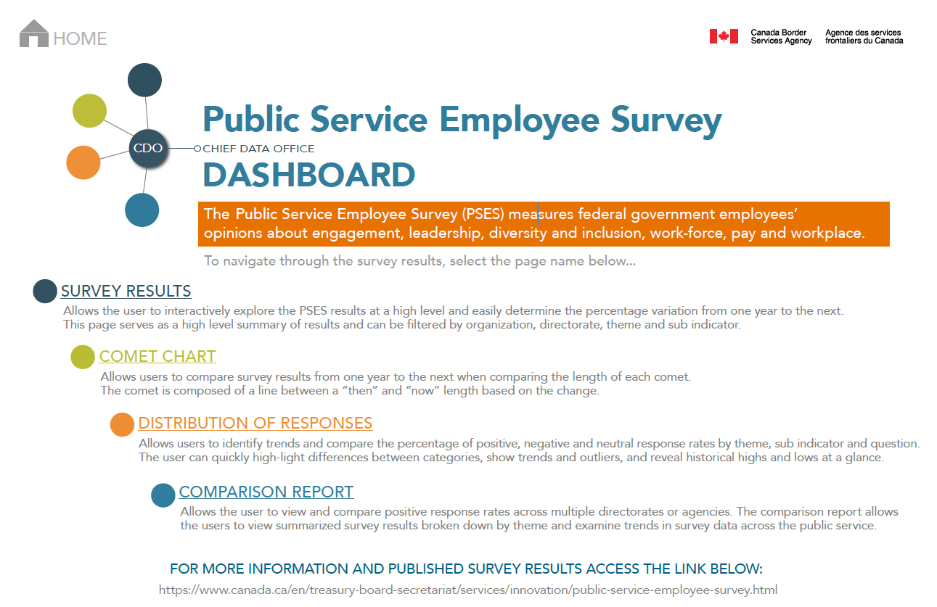
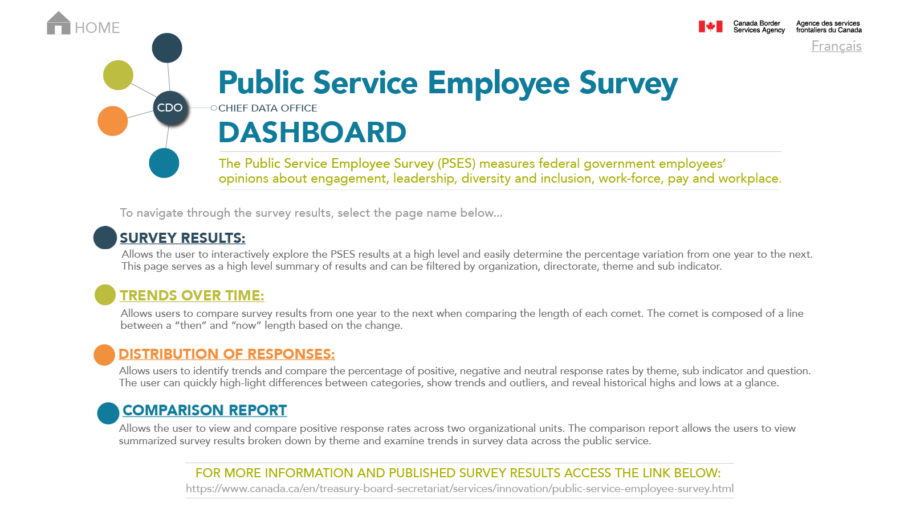
Landing Page Iterations
Week 2.5
Solidifying the design and colors

Slide 9
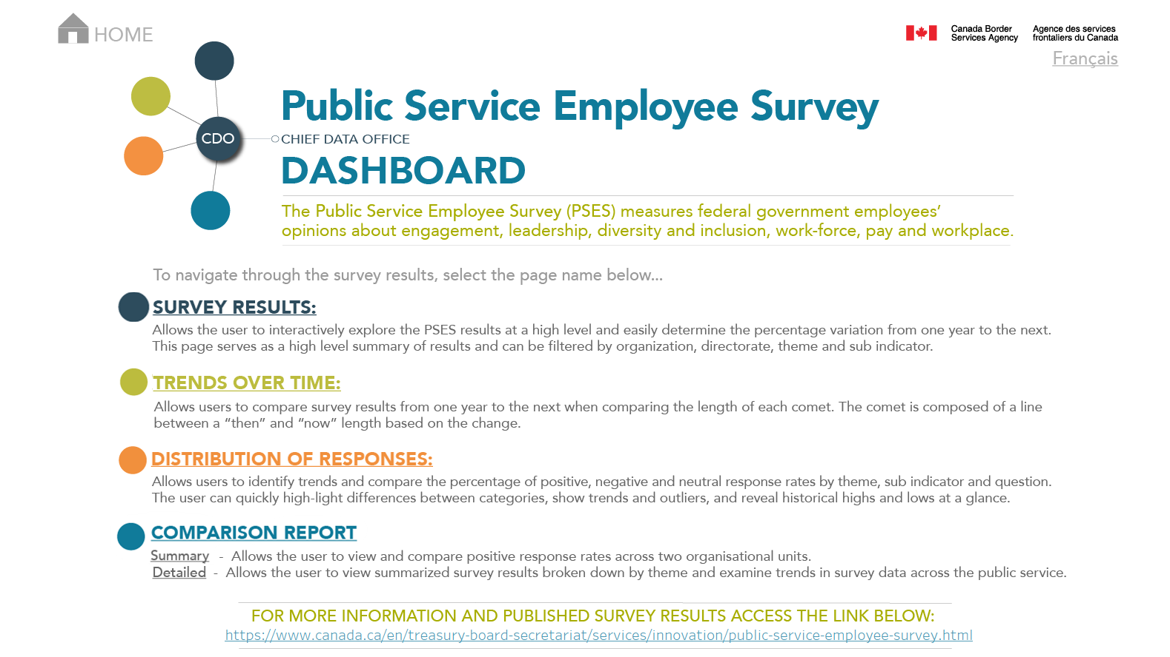
Landing Page Finalization
Week 3+:
Final landing page design gives off a clean and comfortable aesthetic that is easy to navigate
Addition of toggle-able French language (not yet implemented)

Slide 10
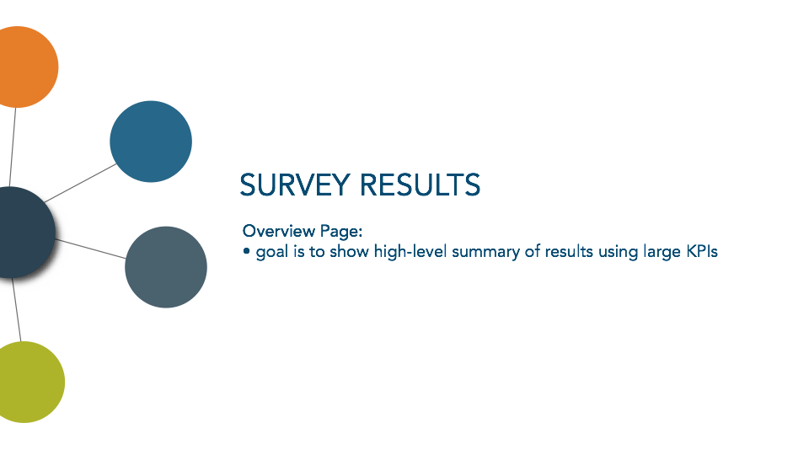

Slide 11


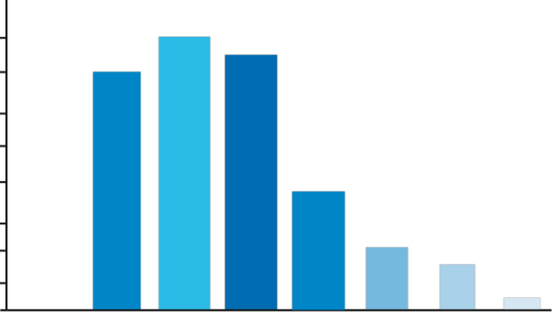

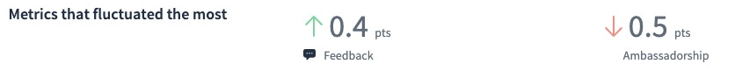
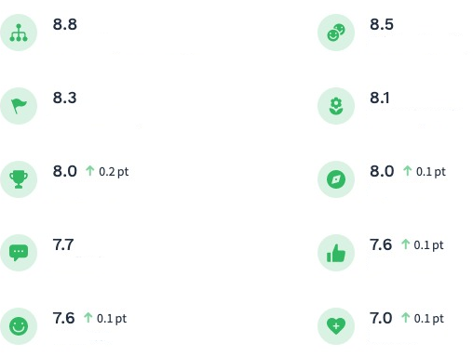
Survey Results Analysis
PSES Results Visualization Tool
Filter 1: Agency > Directorate
Filters under title
Overall Score
Score by Survey Category (%)
Overall % most positive answers with a compare to last years results (i.e increased by 5%). Include participation %/# if we have the data.
86%
%
Bar chart w % of positive answers by theme
Menu
Survey Results Analysis
Question Detail
Comet Chart
Comparison
Left hand menu navigation between screens
Included metrics that fluctuated the most (one +, one –)
Theme
Week 1.5:
Concept drafted by Melanie
Score by Survey Category
My Job
Mobility and Retention
(*) drill through capability to Question Detail Report
My Work Unit
Harassment
% of positive answers by theme with a compare to last years results
My Immediate Supervisor
Discrimination
Senior Management
Stress and Well-Being
My Organization (Department or Agency)
Duty to Accommodate
Notes:
This main screen defaults to the most recent PSES results year and compares to the last year prior to current.

Slide 12
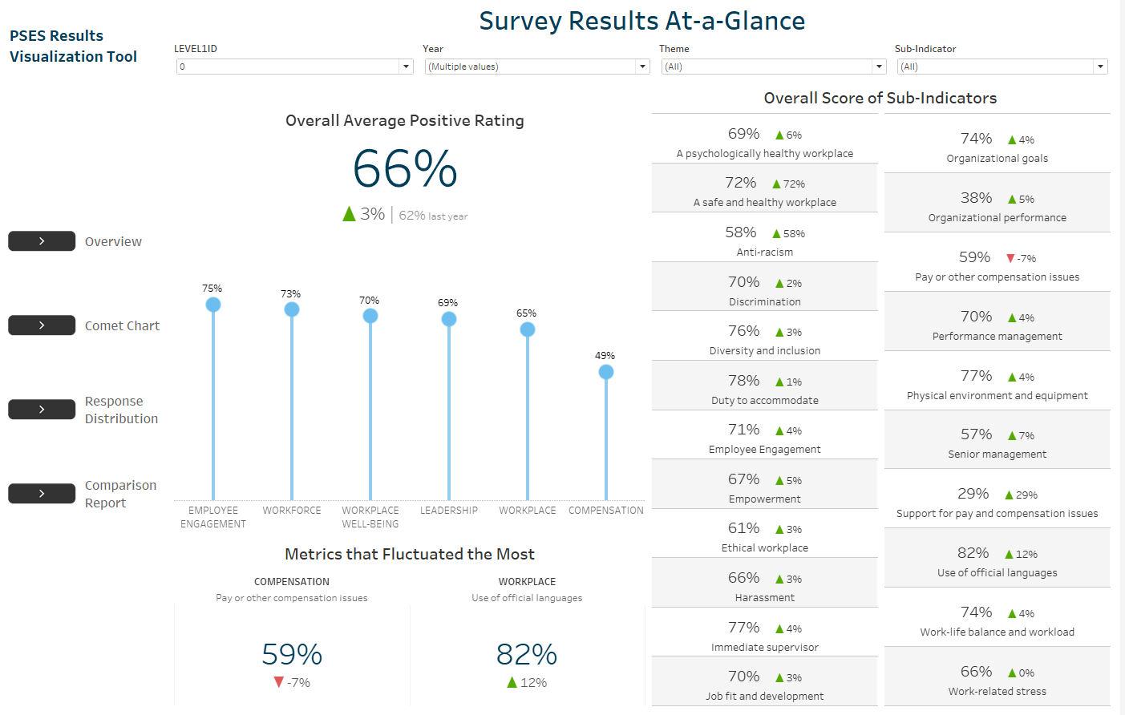
Week 2.5:
Implementation of concept in Tableau
Lollipop charts used over bar charts due to similarity in percentages
Bottom left KPI show most improved and most decreased sub-indicators
Discussion:
Overall Average Positive Rating does not pop out enough
Sub-indicator list is messy & cluttered

Slide 13
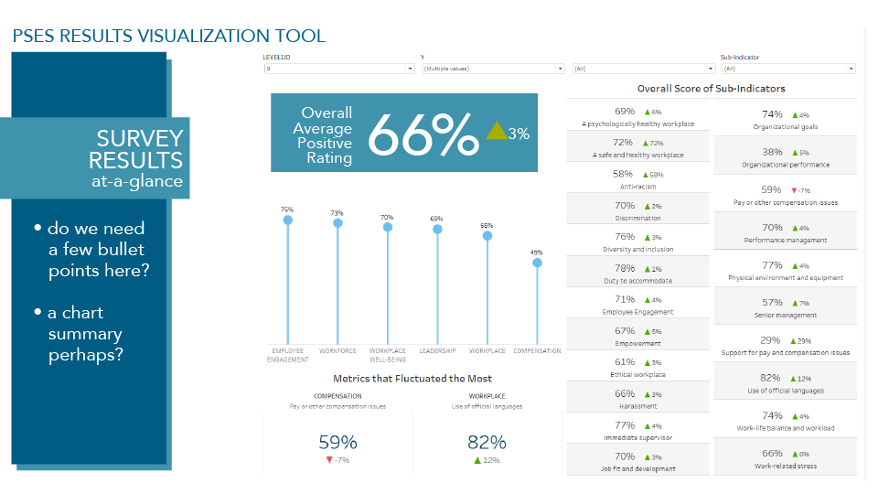
Week 2.5+:
Draft created by Lori
Discussion:
Left blue ribbon looks really pretty, but the saliency of it will draw attention away from data itself
Opted for a grey-colored menu
Great colors for overall APR highlight that will be implemented

Slide 14
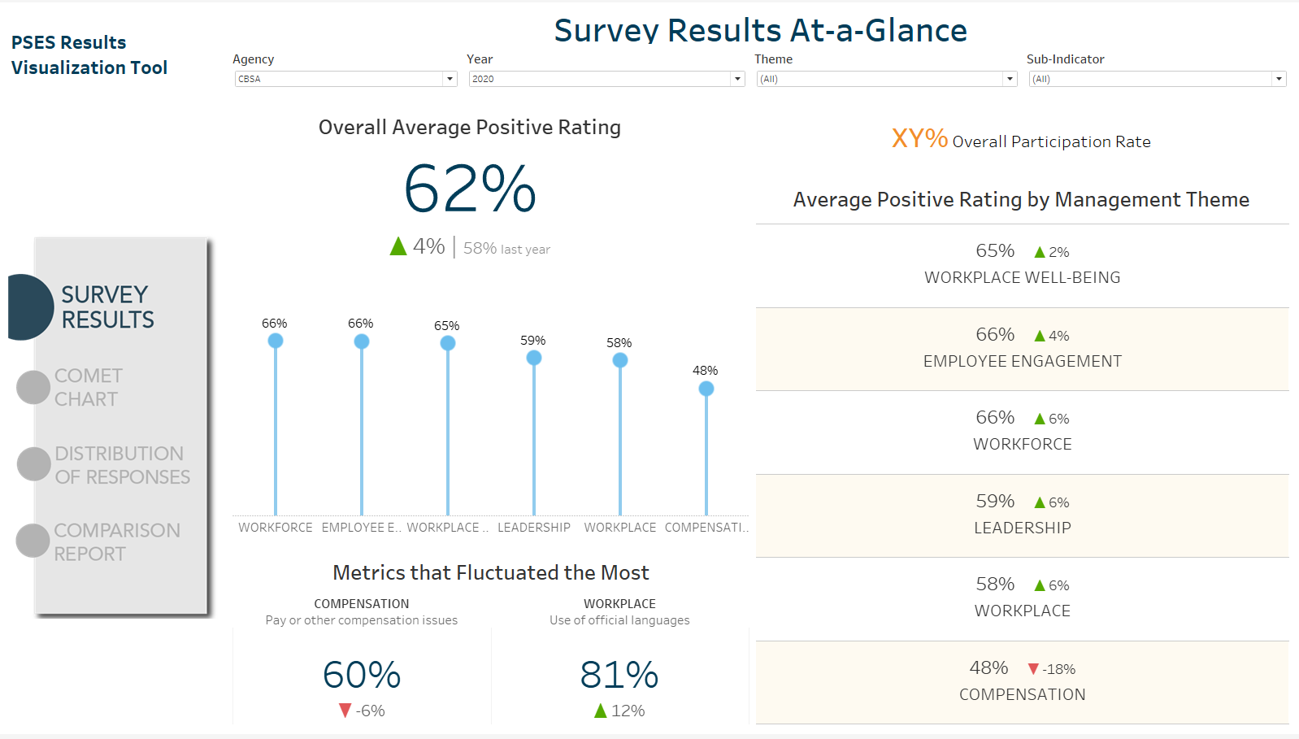
Week 3:
Implementation of Lori’s menu design
Overall participation rate included for each agency
Idea to click on lollipop, and drill down on sub-indicators in theme
Discussion:
Not really any data for overall participation rate in public CSV
Right-side ratings is redundant to lollipop when unfiltered

Slide 15
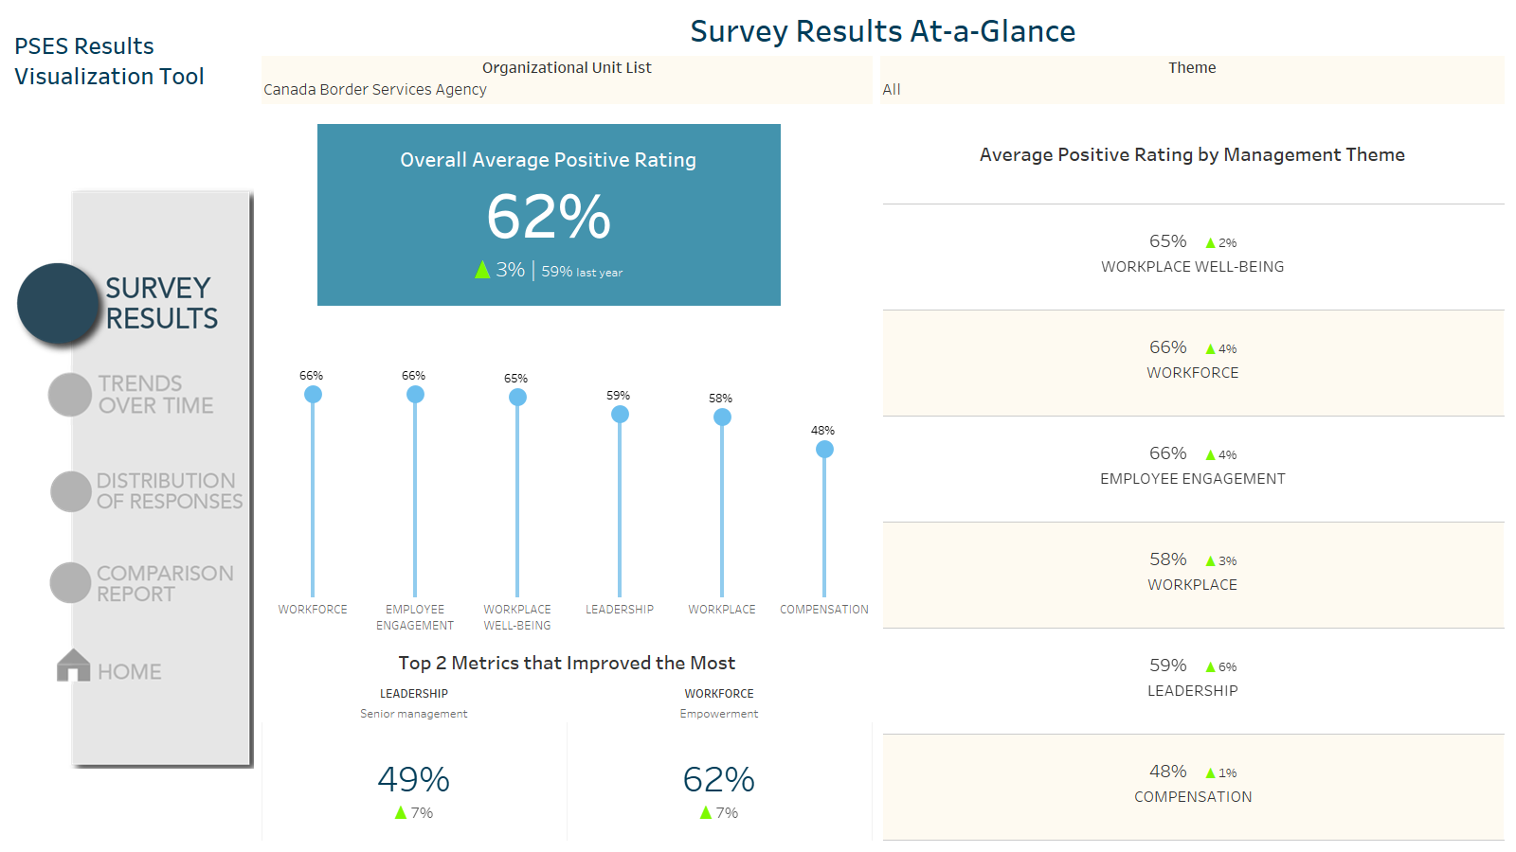
Week 3.5:
Blue padding color added to overall APR to make the highlight more salient
Added yellow shading to filter for contrast and readability
No sub-indicator decreased, so used top two metrics that improved most
Removed overall participation rate (deemed not important)
Triangles made brighter green to contrast with blue padding

Slide 16
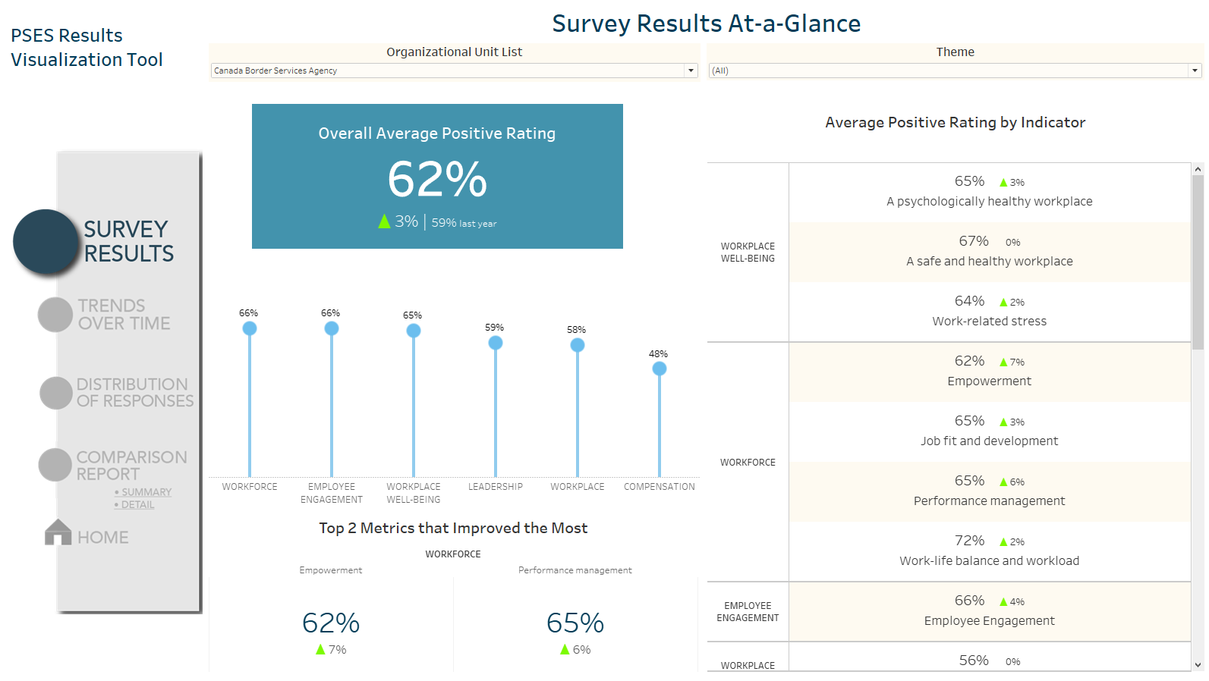
Week 4 Finalization:
Right-side ratings shows sub-indicators grouped by management theme
Ratings will now filter on click of lollipop theme

Slide 17
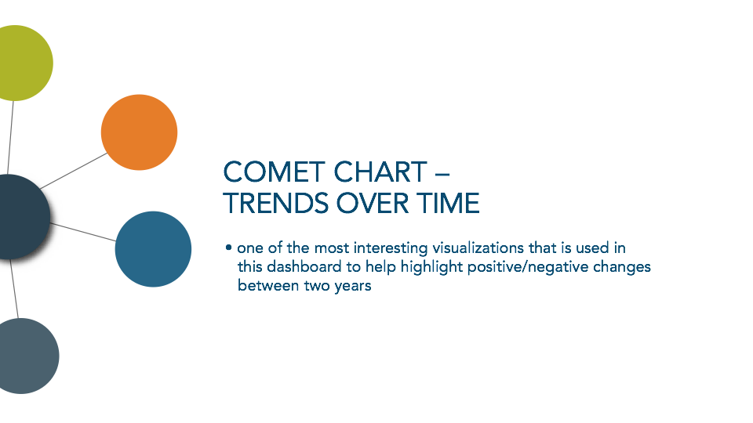

Slide 18
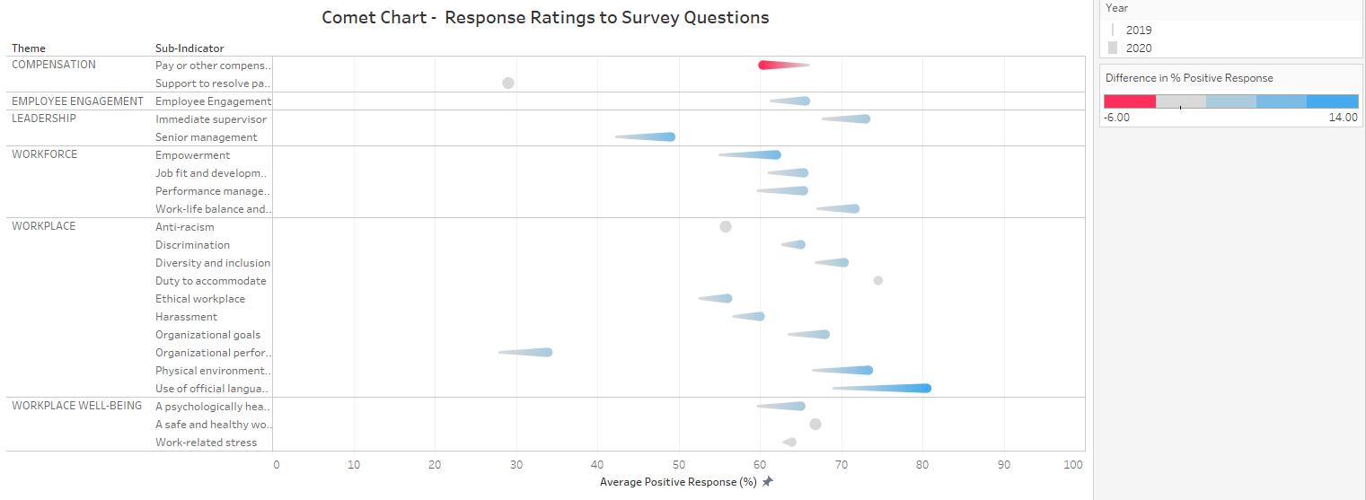
Comet Chart
PSES Results Visualization Tool
Filter 1: Agency > Directorate
Filter 2: Year
Filter 3: Theme/Category
Week 1.5:
Concept drafted by Melanie with screenshot of comet chart
Menu
Survey Results Analysis
Question Details
Comet Chart
Comparison
Notes:
This main screen defaults to the most recent PSES results year and compares to the last year prior to current.

Slide 19
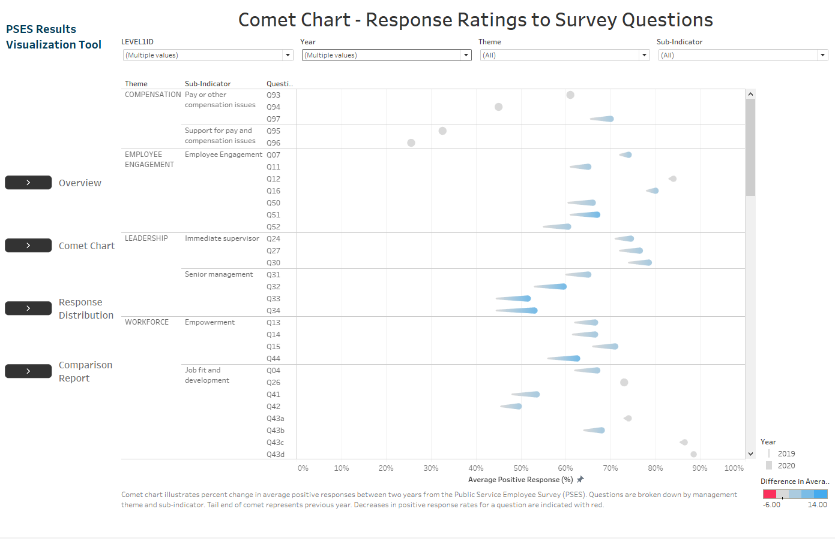
Week 2
Originally started with bright pastel blue/red for the comets rather than typical green/red for color-blind friendliness
Hierarchical design allows user to drill down/up on survey
Discussion:
Design for comet chart was conceived and implemented the earliest in the dashboard
As one of the foundational visualizations, a lot of design ideas were based off of this

Slide 20
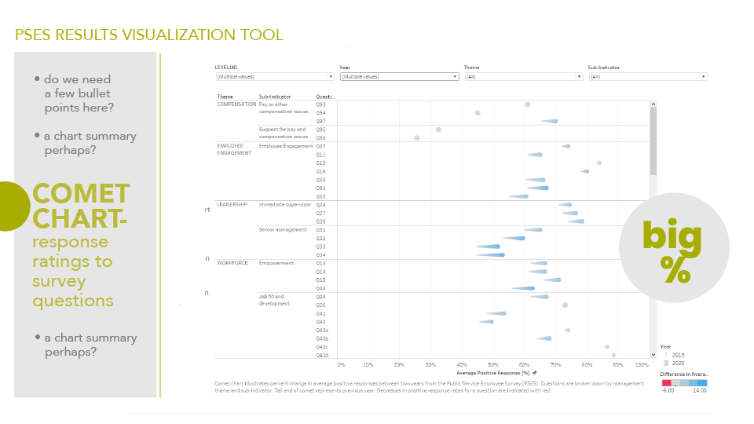
Week 2.5
Design by Lori

Slide 21
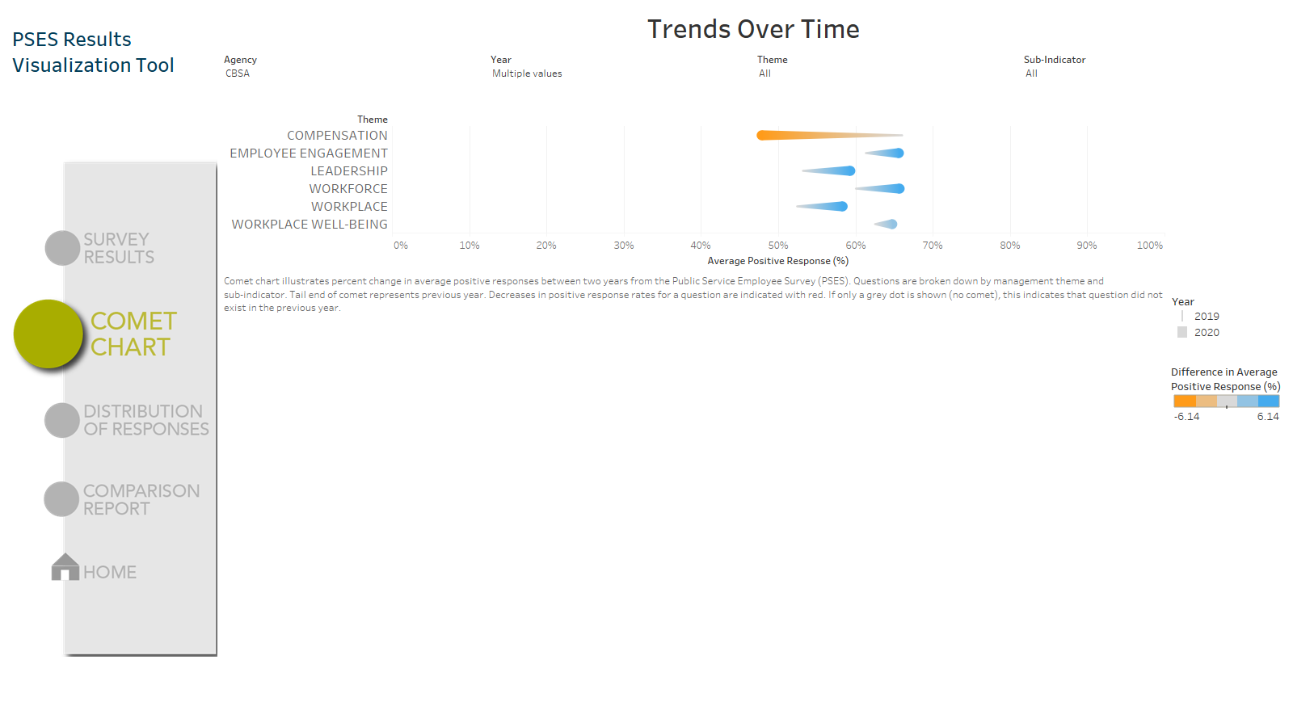
Week 2.5
Changed to blue/orange to match consistency of color design in other visualizations
Discussion:
Despite being earliest to finish in design, there was an issue in calculating the averages (see the massive orange fireball under compensation)

Slide 22
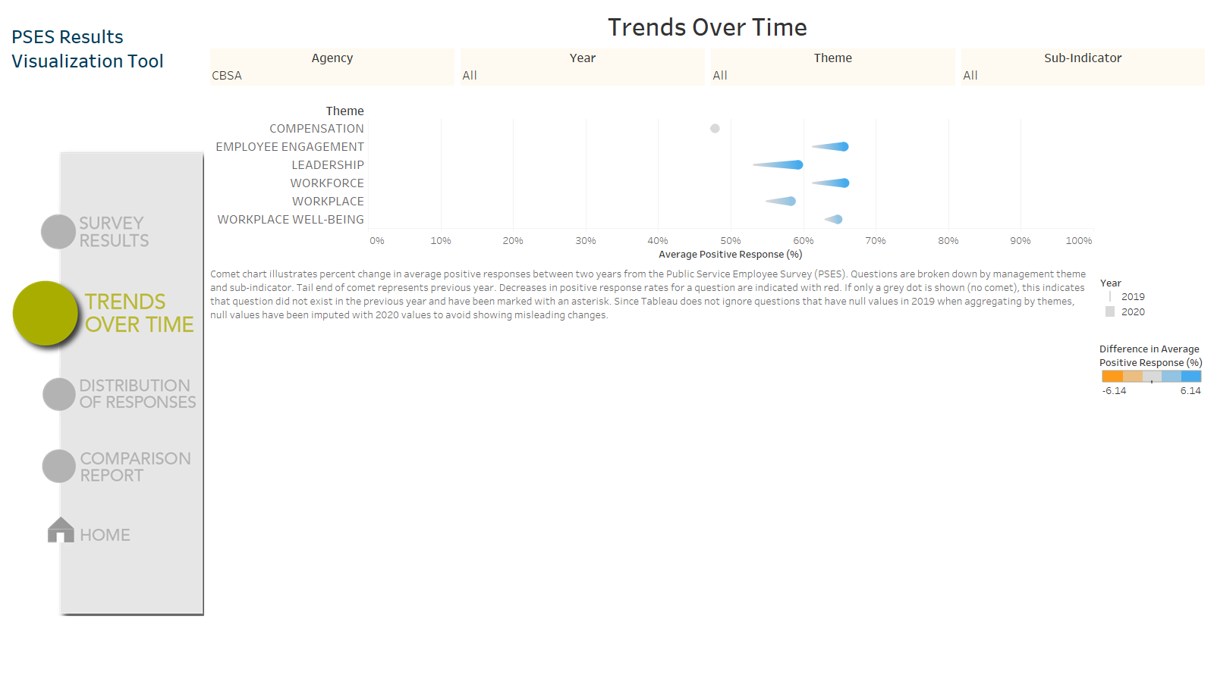
Week 3+ Finalization
Questions that were missing in 2019 were imputed with 2020 values to fix this averaging issue
Discussion:
This imputation will remain as a temporary fix until future survey responses are included

Slide 23
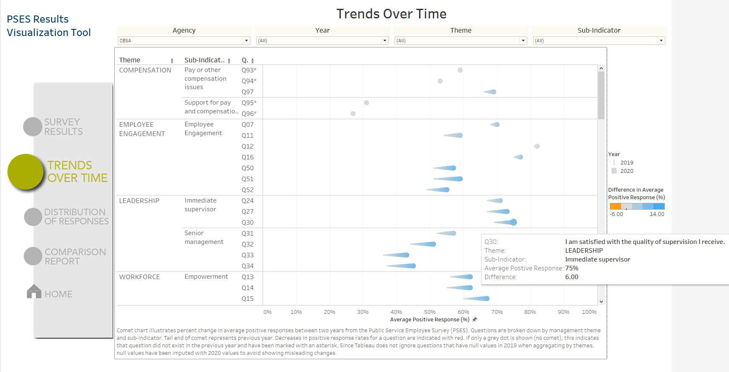
Week 3+ Finalization
Example tooltip of a increase in APR between 2019-2020 in question Q30

Slide 24
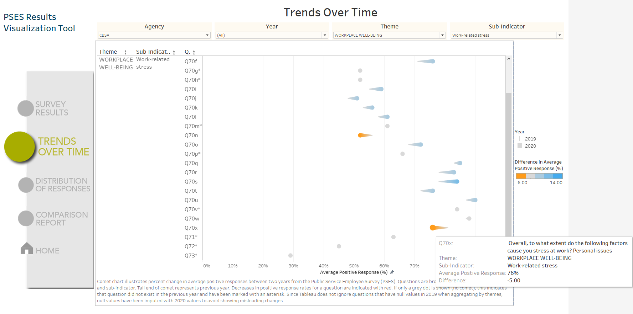
Week 3+ Finalization
Example tooltip of a decrease in APR between 2019-2020 in question Q70x

Slide 25
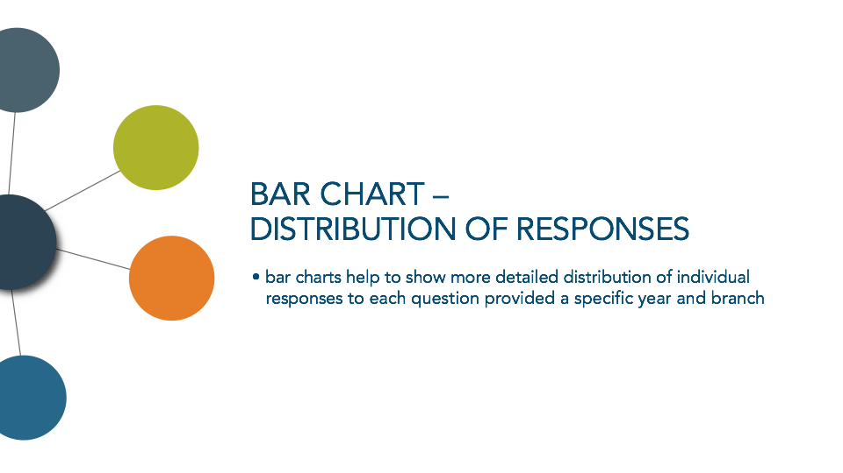

Slide 26
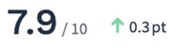
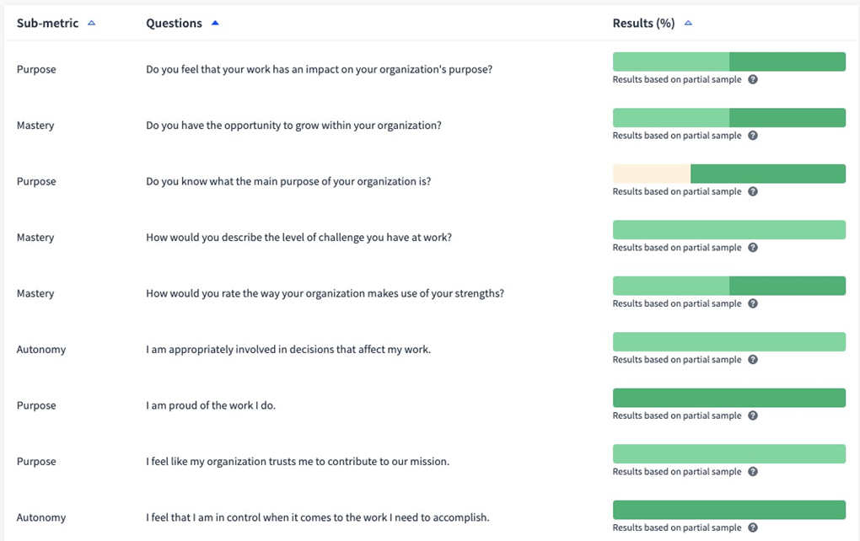
Question Details
PSES Results Visualization Tool
Filter 1: Agency > Directorate
Filter 2: Year
Filter 3: Theme/Category
Category: Compensation
Theme w overall % of positive results & amount increased or decreased from last year.
Week 1.5
Concept drafted by Melanie
Menu
Survey Results Analysis
Question Details
Comet Chart
Comparison
Include all answer options (agree, somewhat agree etc.) in the bar
Notes:
This main screen defaults to the most recent PSES results year and compares to the last year prior to current.

Slide 27
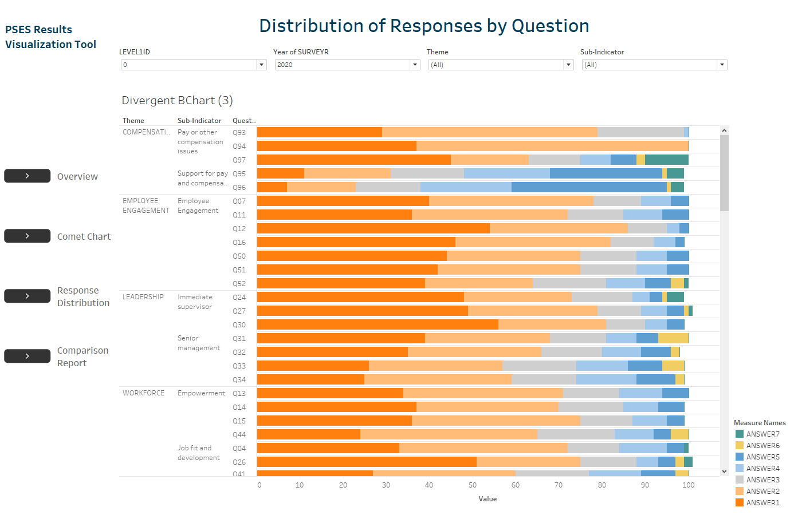
Week 2
Stacked bar chart with all 7 responses
Does not all add up to 100% because data is aggregated and rounded
Discussion
Realized that ANSWER1 in orange is not always the same and varies across each question. Might be “strongly disagree” or “not at all”
Could be positive or negative response depending on question

Slide 28
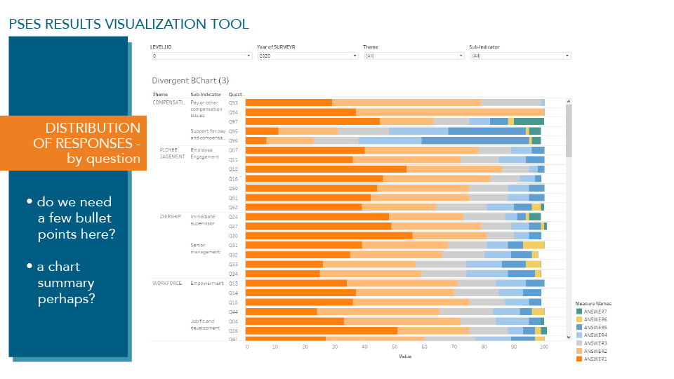
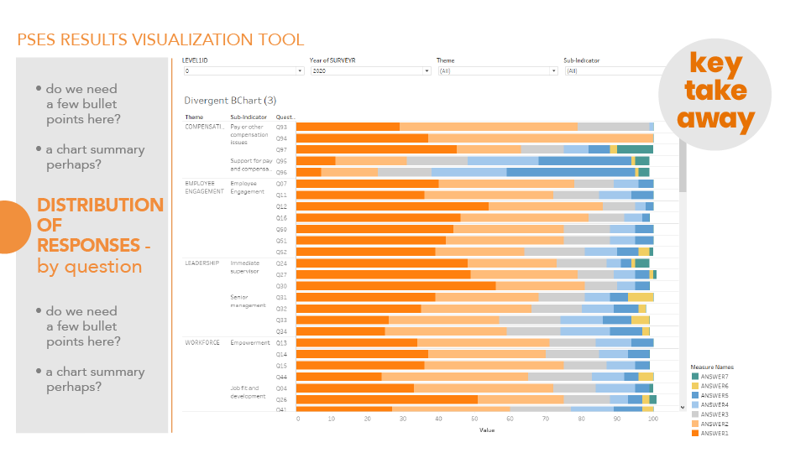
Week 2.5
Drafts by Lori
Comparison of different themes, grey menu really matches the white background
Avoided using “key take away” in this dashboard to let the user come to their own conclusion

Slide 29
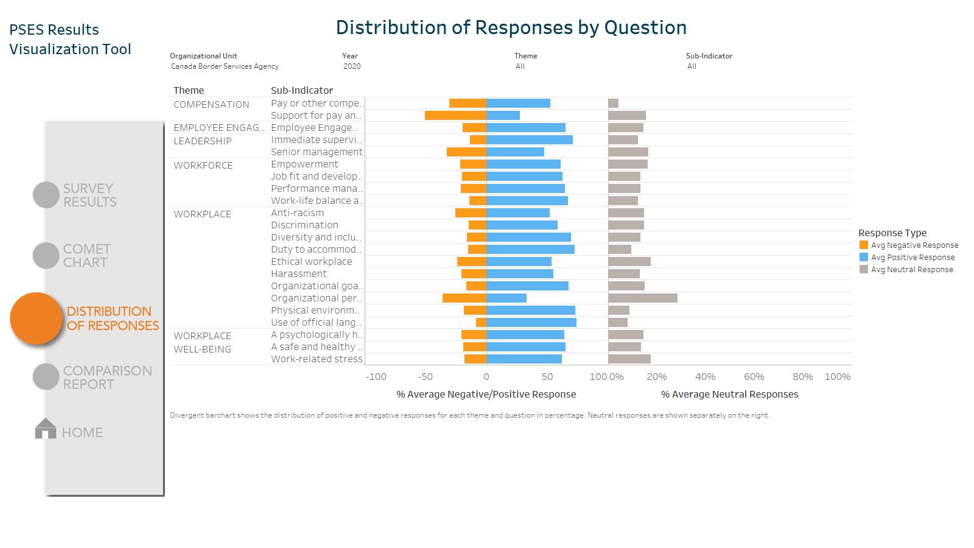
Week 3
Diverging bar chart shows total negative, positive, and neutral responses
Discussion
Orange colored data will always correspond to negative response for consistency
Used complimentary colors for higher contrast

Slide 30
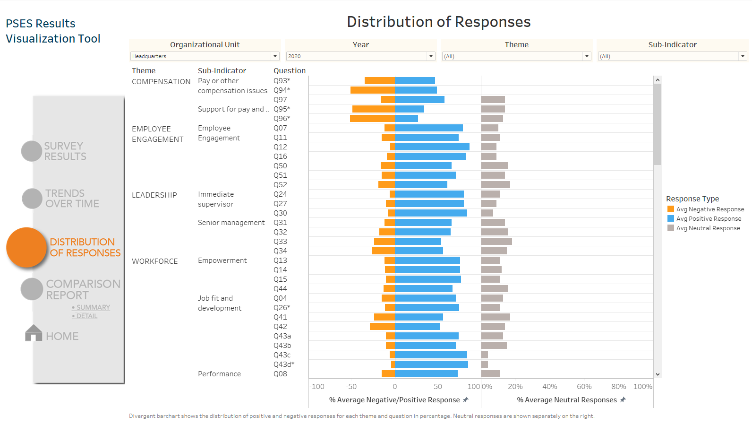
Week 4 Finalization Discussion
“I don’t know” and “Not applicable” responses should be included in a different shade in the neutral response section (not yet implemented)

Slide 31
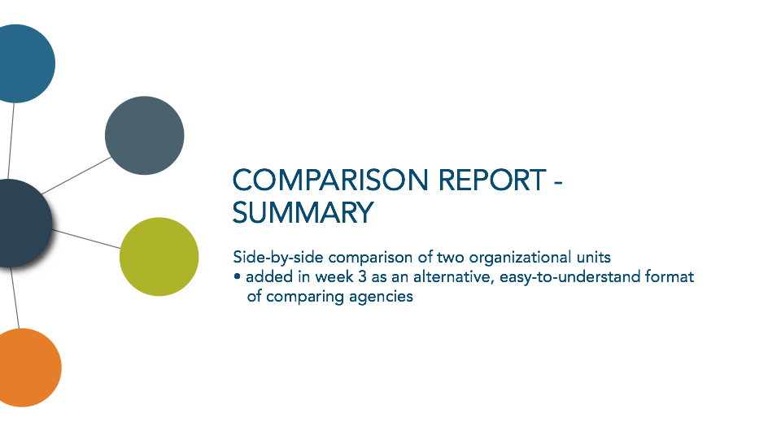

Slide 32
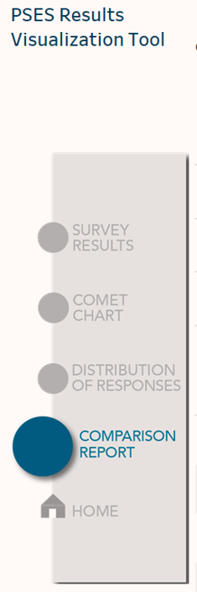
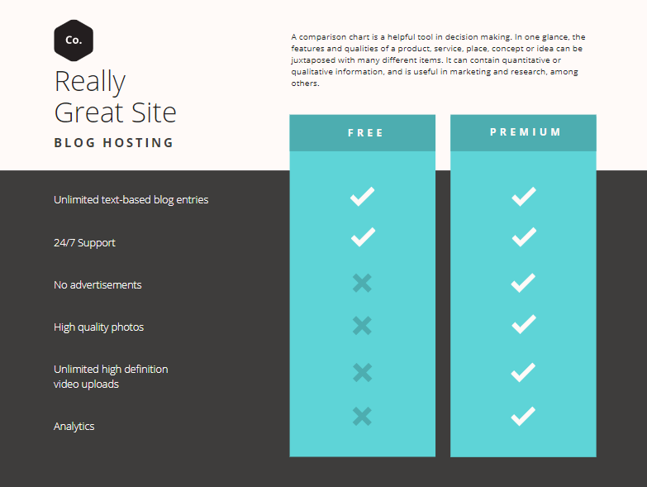


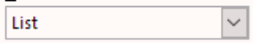



Comparison Report
Select the two organizational units to compare in the below filters. Filter 1 will be compared against Filter 2.
CDO
CBSA
Use filter to select unit
Use filter to select comparable unit
Week 3
Concept drafted by Melanie
Similar to comparisons used in websites when looking at car specs online
Colored text indicate increase/decrease from comparison
Overall Average Positive Response
75%
67%
Compensation
54%
68%
Employee Engagement
46%
68%
Leadership
82%
80%
Workforce
95%
78%
Workplace
66%
64%
Workplace Well-Being
54%
68%
Note- Orange highlight reflects percentages that fall below the comparable unit’s average.

Slide 33
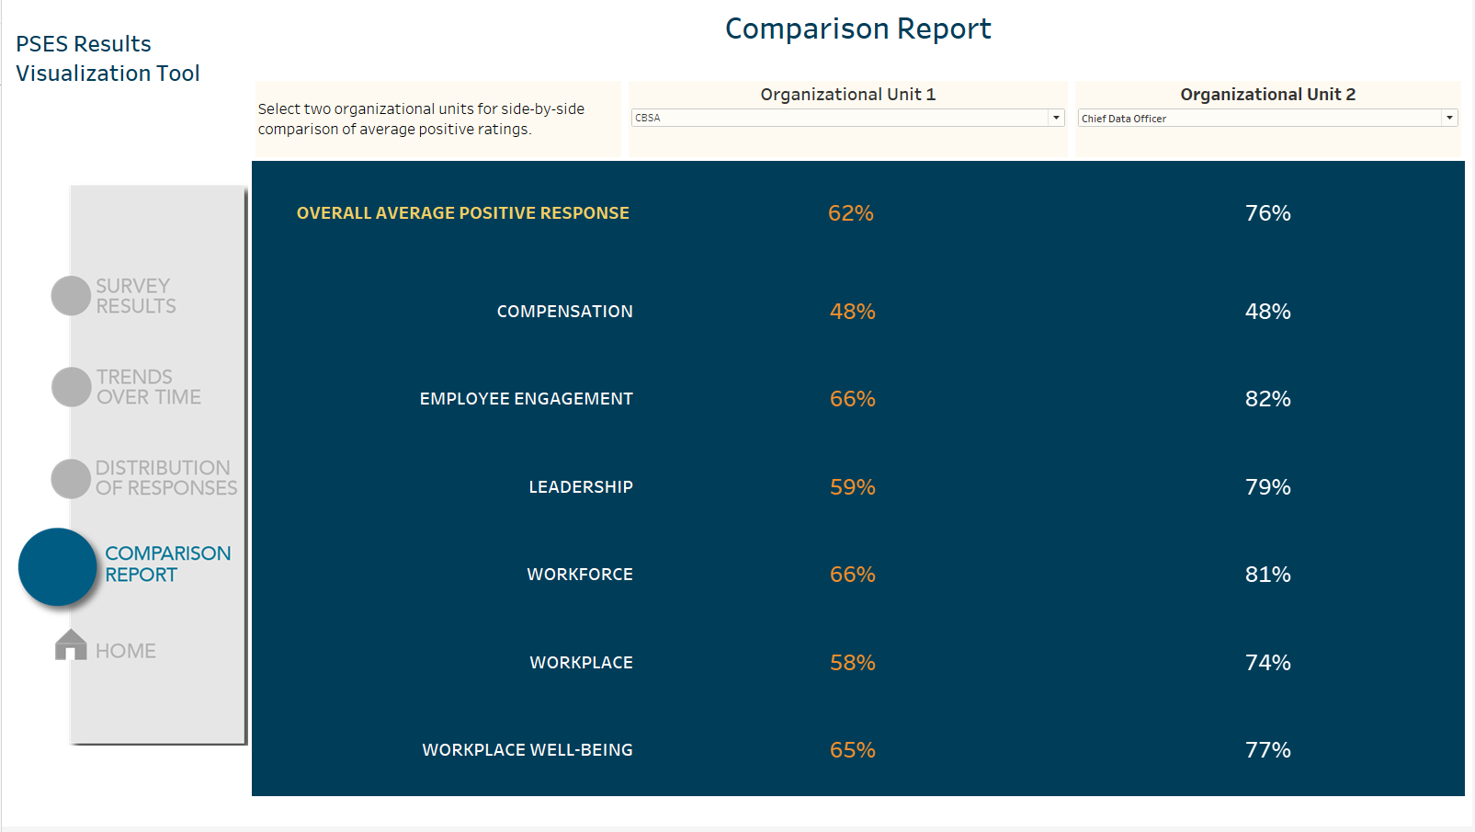
Week 3.5
Initial implementation
Navy blue used over black to match CBSA theme
Discussion
Columns and cells need division to separate header from data
Colored text to detect differences on two separate filters is difficult to achieve in Tableau, should keep all numbered text as white

Slide 34
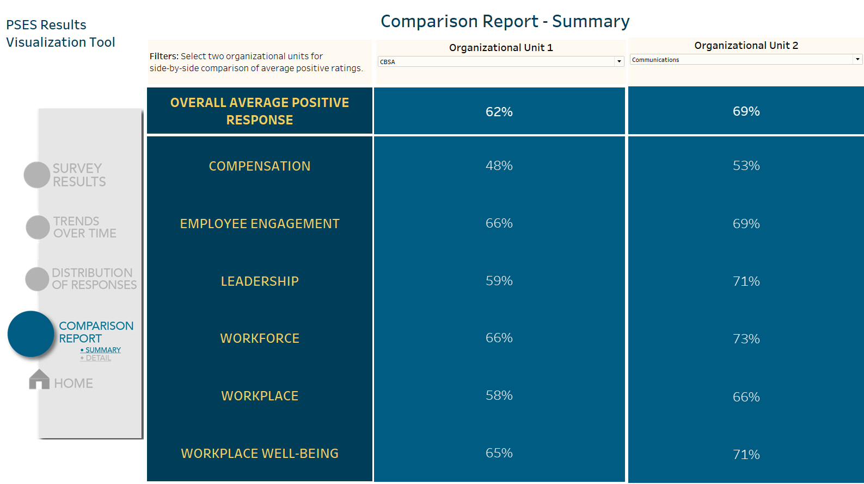
Week 4 Finalization
Golden text to highlight headers
Discussion
A graphical representation of this (grouped bar charts) might be easier to visually detect differences for comparison

Slide 35
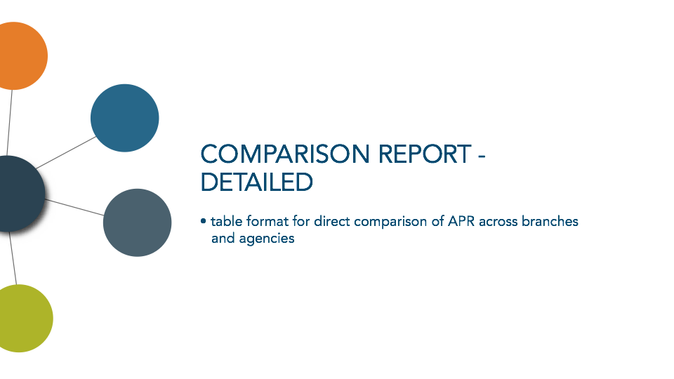

Slide 36
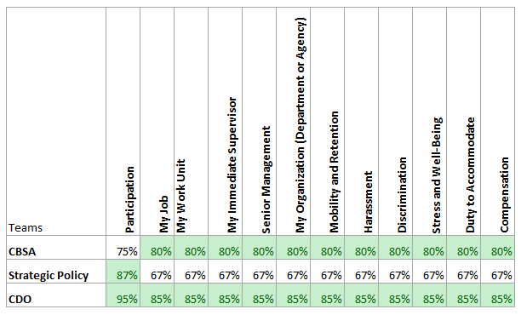
Comparison Report
PSES Results Visualization Tool
Filter 1: Agency > Directorate
Filter 2: Year
Filter 3: Category
Week 1.5
Concept drafted by Melanie
Menu
Survey Results Analysis
Question Detail
Comet Chart
Comparison
Is there an option to do a multi select filter on teams? One person may want to see CDO compared to CBSA, but someone else may want to see various CDO’s compared to one another.

Slide 37
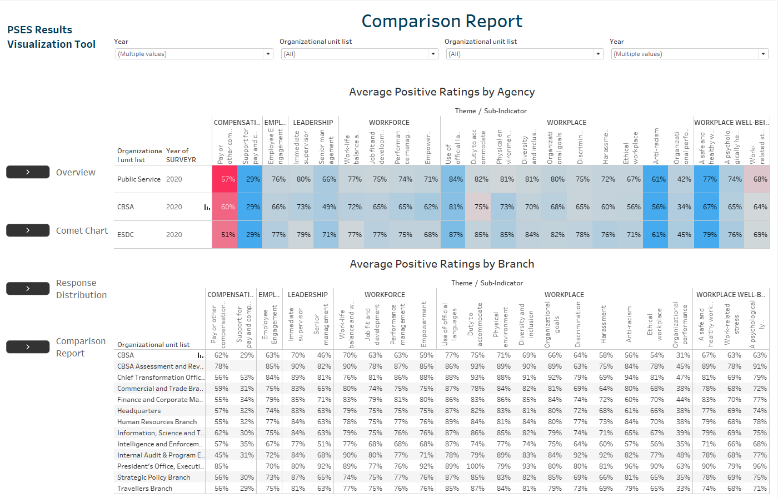
Week 2
Colors in top table indicate comparison to previous year
Discussion
Lots of information in this page, meaning of color is not readily apparent in top table
Lots of branches and agencies, need to select default ones to compare against

Slide 38
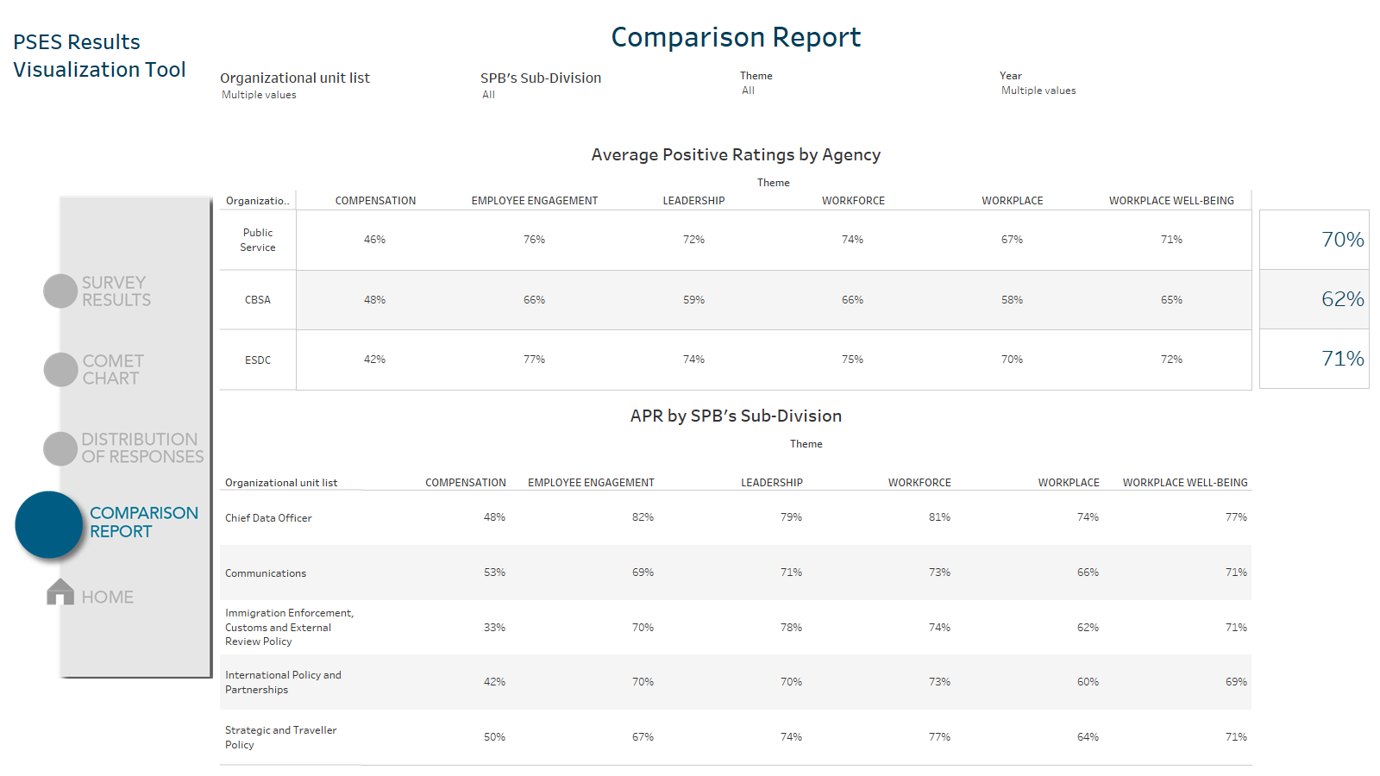
Week 3
Simplification of table to look at overall percentages per theme
Difficulty incorporating overall APR (blue numbers on right)
Discussion
Design is a little bland, but it shows the right kind of information for branches/agencies comparison

Slide 39
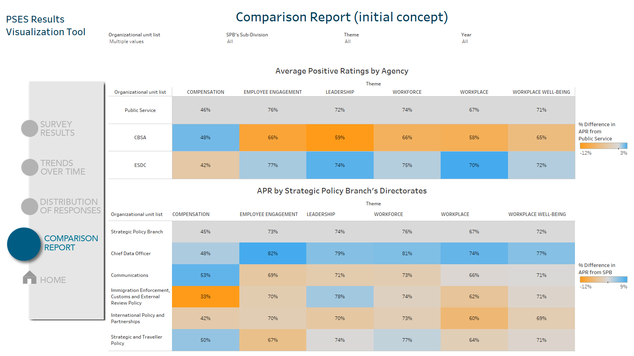
Week 3.5
Addition of cell colors to show difference between select branches and top row
Discussion
Colors are really meaningful and we can easily see which themes show the most increase/decrease in APR

Slide 40
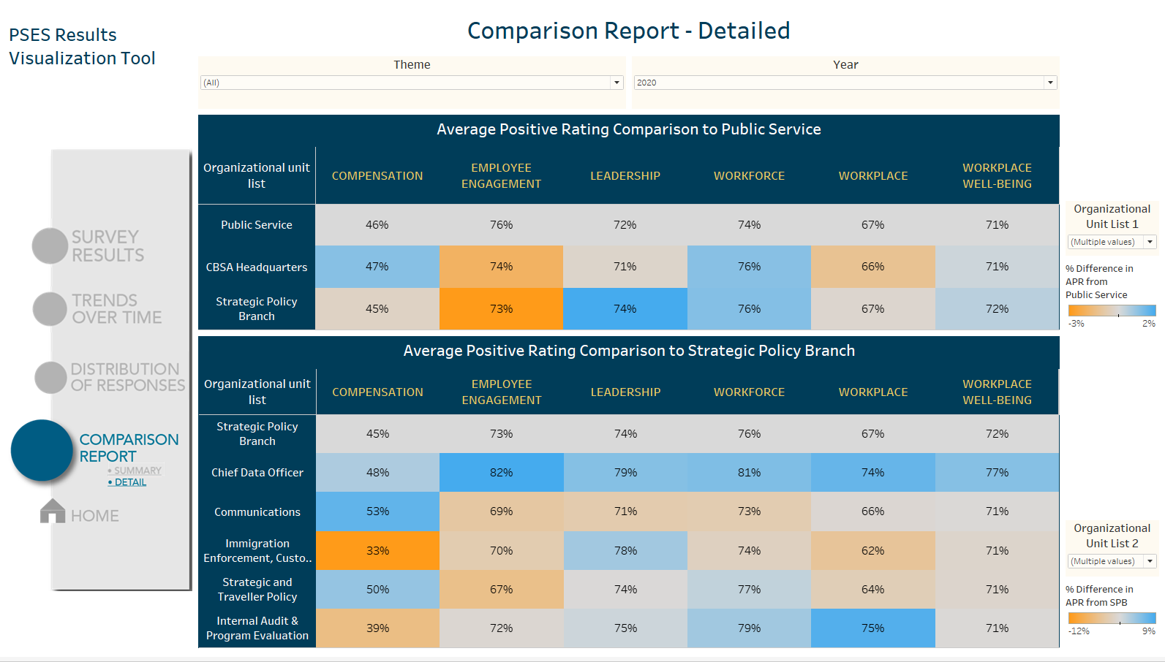
Week 4
Added background color and filters on side
Discussion
Navy blue background implemented to show similarity in theme to “Comparison Report – Summary”
Navy blue and gold text used in CBSA badge colors. Colors increase readability and adds a bit of flair to the table

Slide 41
